Slide 1
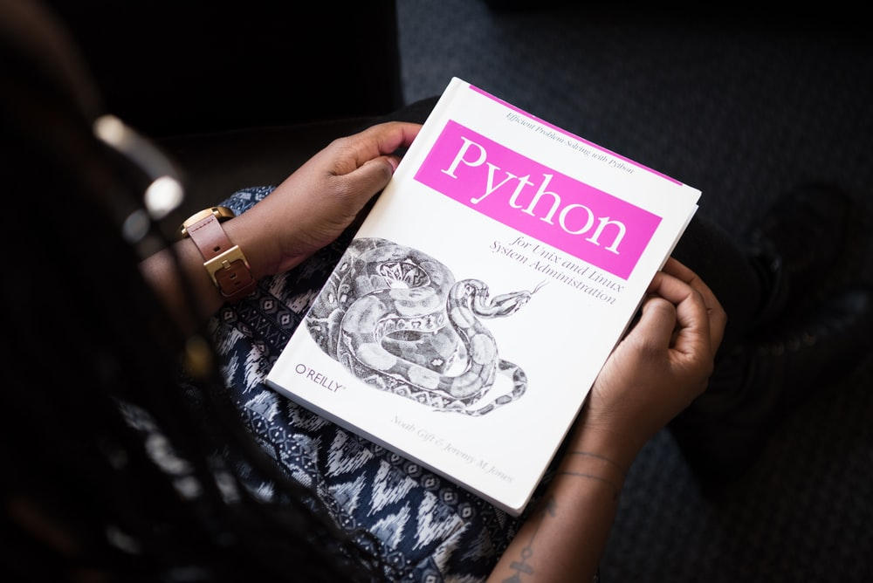
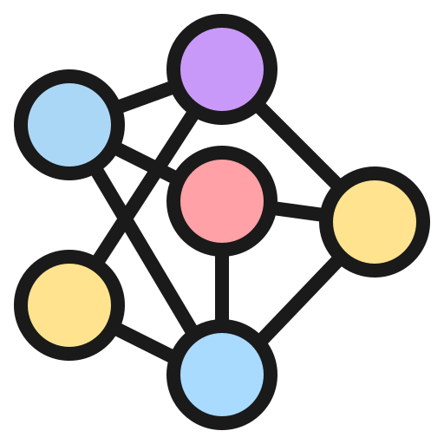




A Comprehensive Guide to Ensemble Models
Bagging
With Python Codes
Boosting
Stacking
Blending

Slide 2


Prediction of Customer Attrition in the Telecom Industry using Machine Learning
Anish Mahapatra | 31 May, 2021

